Slide 1


Introduction to
DBMS

Slide 2
Objective
Introduction to DBMS
Installation of MySQL
DBMS Architecture & Product Design
Create DB, Tables, Schema
Entity Relationships
More on dbms
MySQL & MongoDB

Slide 3
Understanding Data and Generation of Data
Everything that we do generates data, from browsing internet to ATM cash withdrawal.
Data is everything & data is everywhere.
For an e-commerce application - products are data, users are data, purchase is data.
EdYoda - Developer Programs
https://www.edyoda.com

Slide 4
How to store Data?
Data can be stored in RAM.
Data can be stored in flat files stored in File System.
Data can be stored in Databases.
EdYoda - Developer Programs
https://www.edyoda.com

Slide 5
Understanding Database Management System
Database Management System (DBMS) is a software for storing and retrieving users' data while considering appropriate security measures. It consists of a group of programs which manipulate the database.
The DBMS accepts the request for data from an application and instructs the operating system to provide the specific data. In large systems, a DBMS helps users and other third-party software to store and retrieve data.
DBMS allows users to create their own databases as per their requirement. The term “DBMS” includes the user of the database and other application programs. It provides an interface between the data and the software application.
EdYoda - Developer Programs
https://www.edyoda.com

Slide 6
Why learn DBMS ?
Without understanding how is data dealt in a system, we can’t really understand any product.
The main role of developer, testers, automation guys is to add value to the product.
Without proper understanding DBMS, a product can’t be really understood.
EdYoda - Developer Programs
https://www.edyoda.com

Slide 7
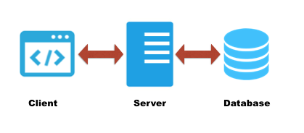
3-Tier Architecture
EdYoda - Developer Programs
https://www.edyoda.com

Slide 8
Types of Database
RDBMS - MySQL
NoSQL - MongoDB
EdYoda - Developer Programs
https://www.edyoda.com

Slide 9
INSTALLATION

Slide 10
Installing MySQL on Windows
Visit the URL below and follow the screenshots.
https://dev.mysql.com/downloads/installer/
EdYoda - Developer Programs
https://www.edyoda.com

Slide 11
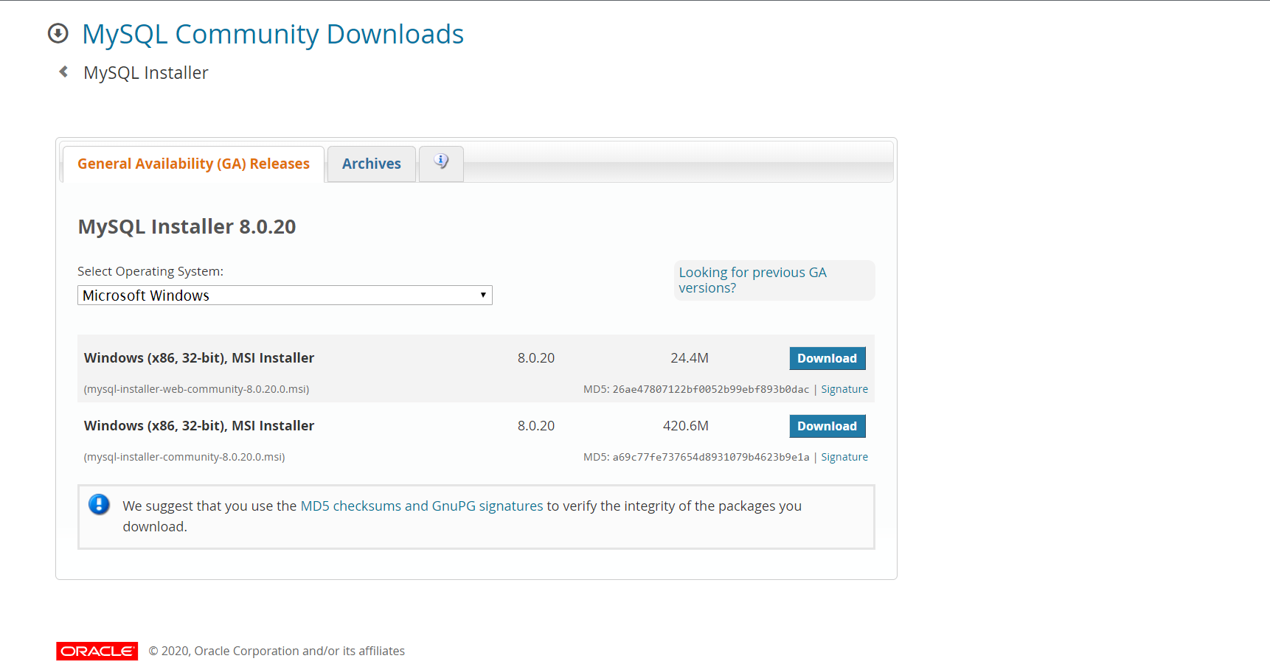
← Click on download button.

Slide 12
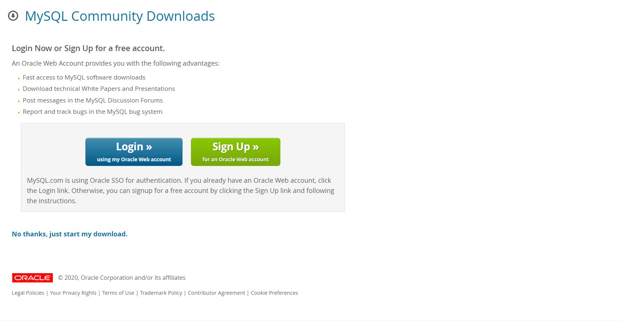
← Click on this link. It should start downloading the installation file.

Slide 13
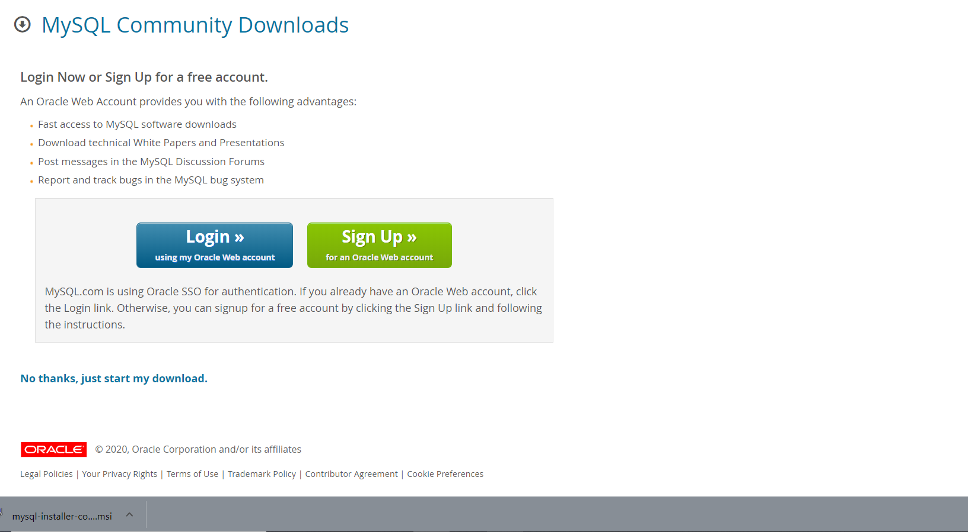
Click to open file.
←

Slide 14
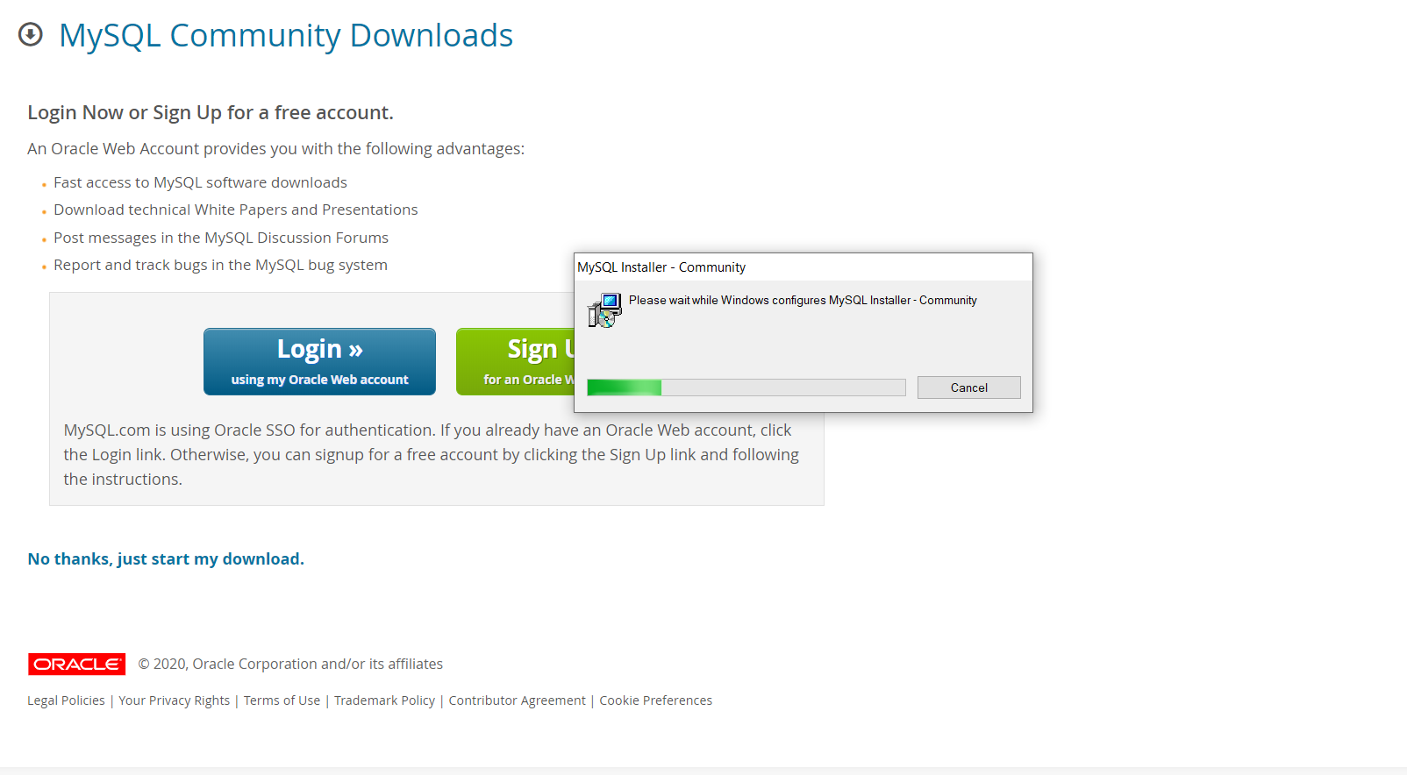
Wait...

Slide 15
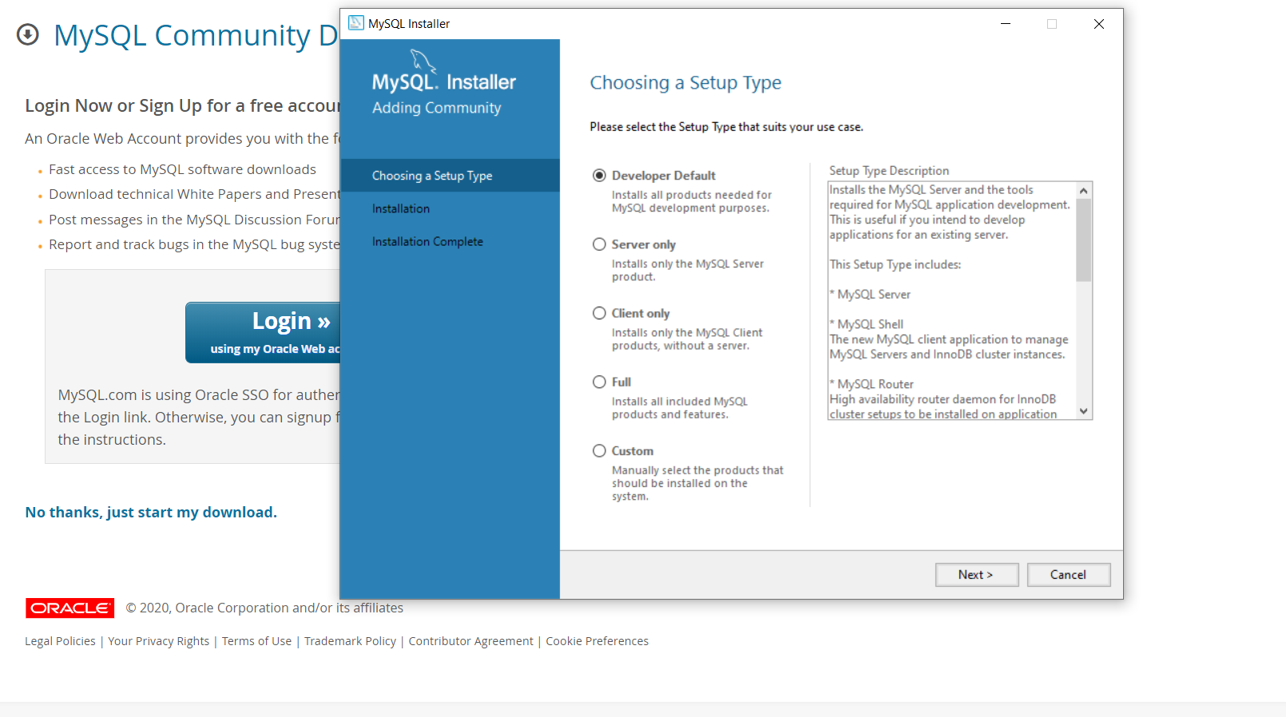
← Select Full Install

Slide 16

Click on Next button -->

Slide 17
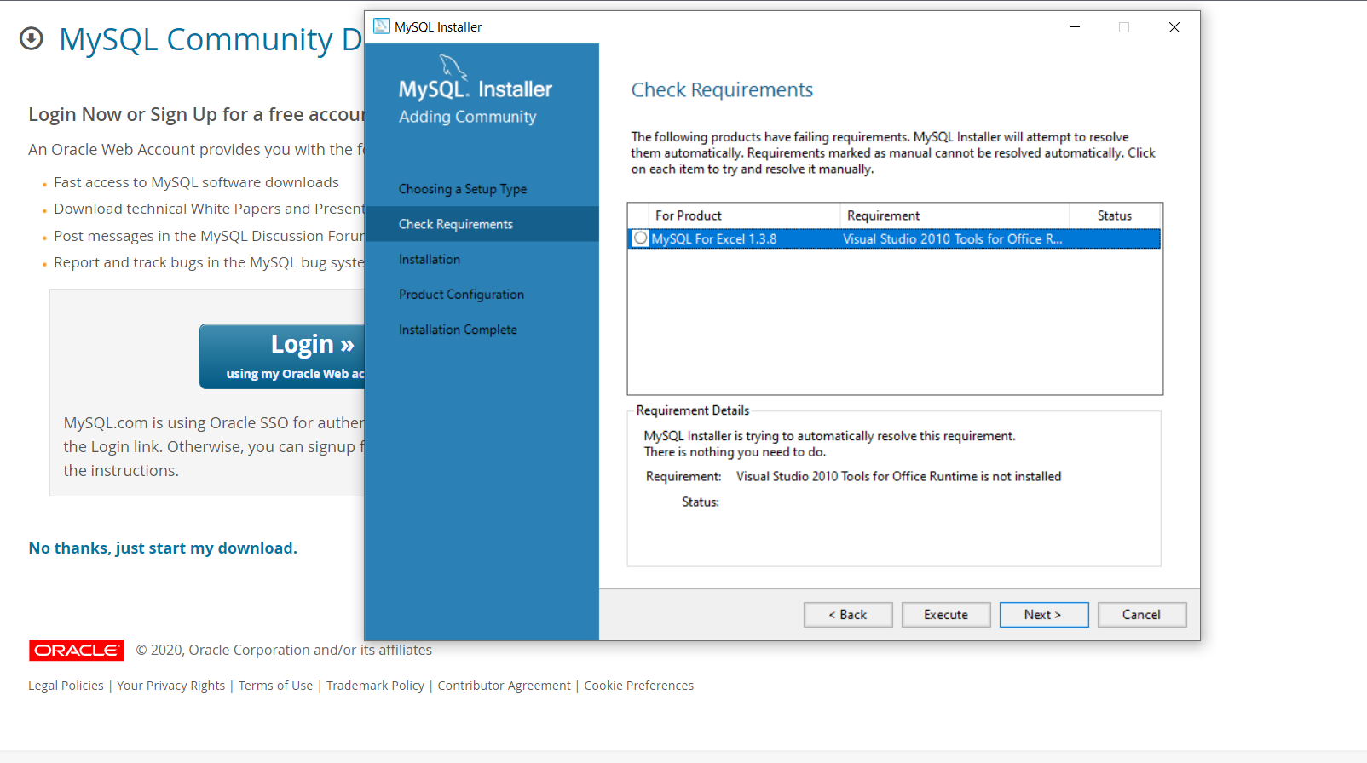
Select all that needs to be installed -->
Click on Next button and install dependencies -->

Slide 18
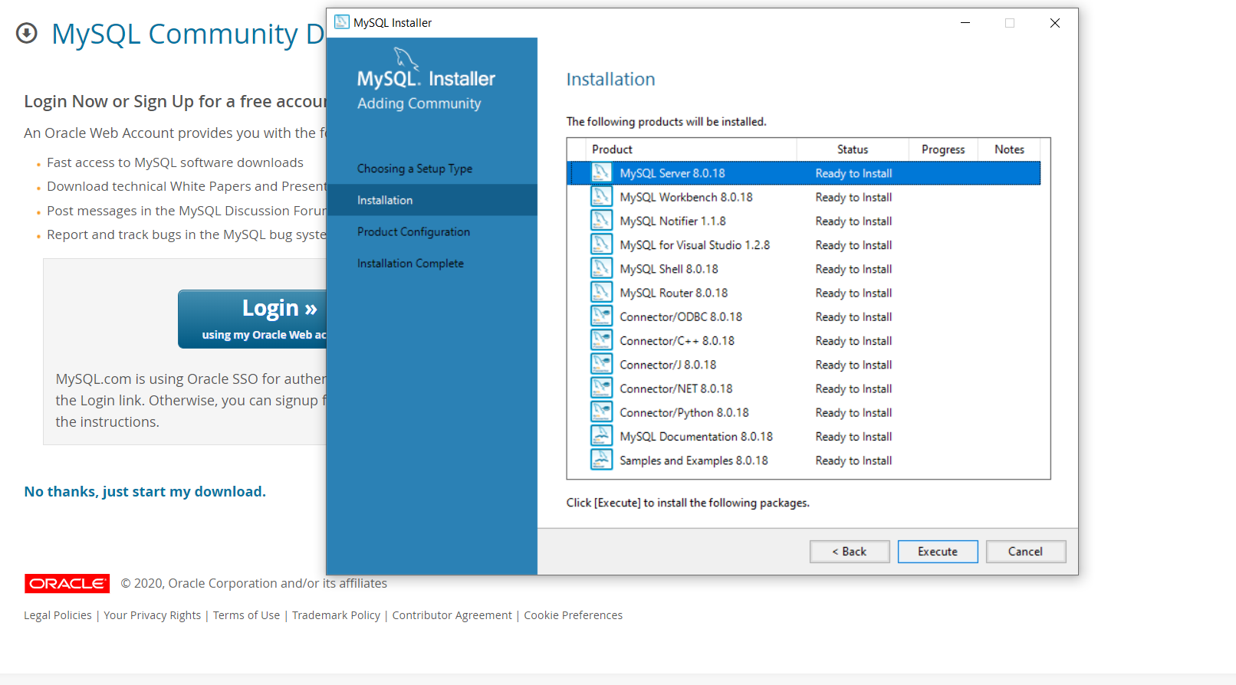
Click on Execute button -->

Slide 19

Wait...

Slide 20

Wait...some more time...

Slide 21

Click on Next button -->

Slide 22
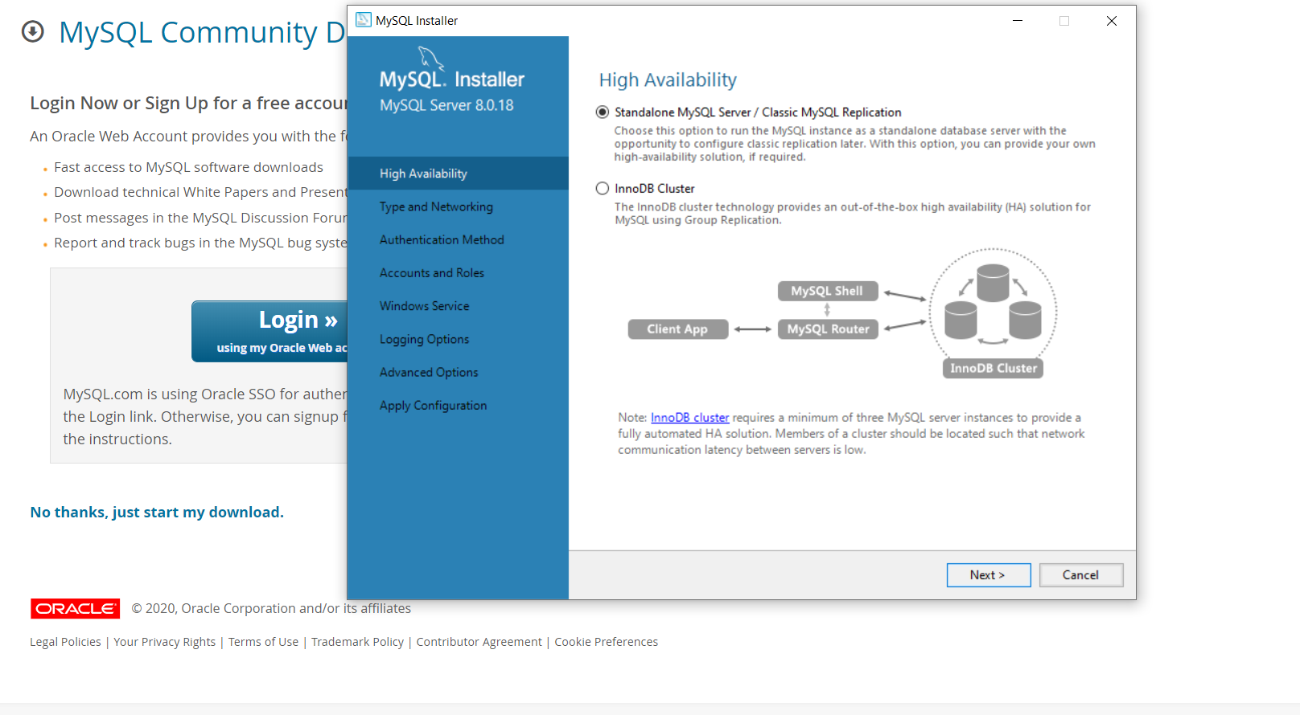
Click on Next button -->

Slide 23
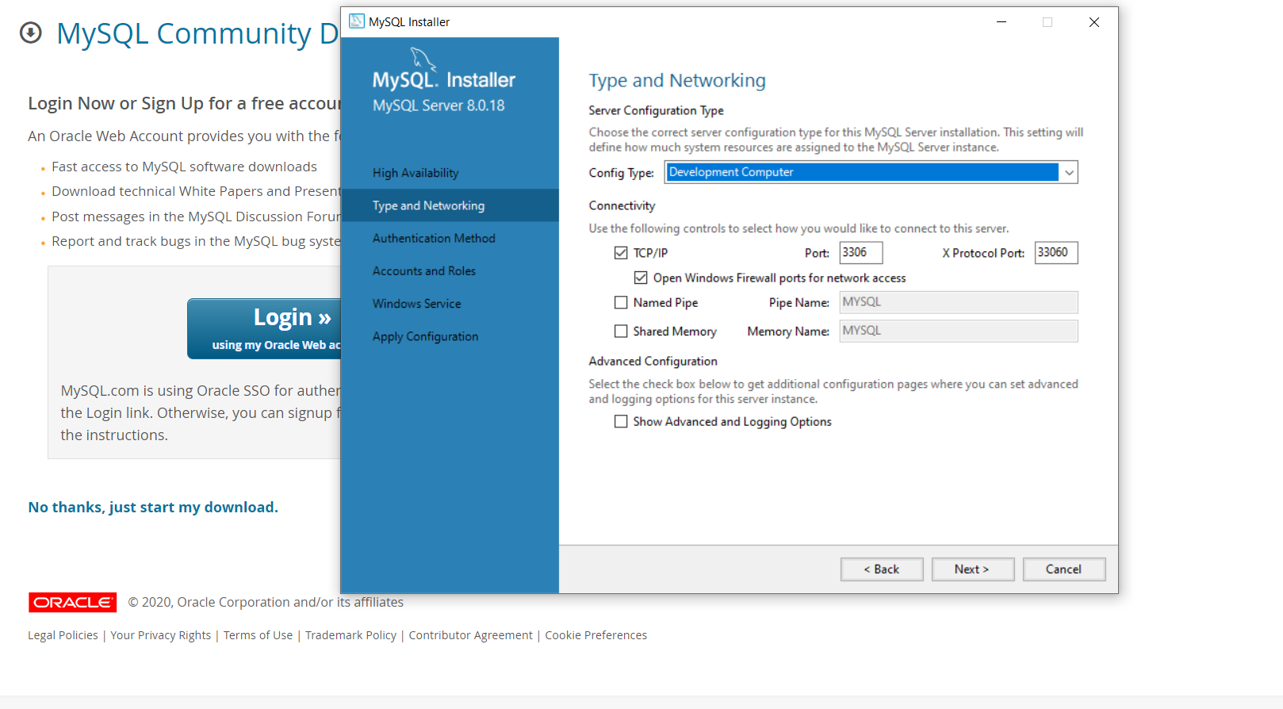
No changes here. Click on Next button -->

Slide 24

Click on Next button -->

Slide 25
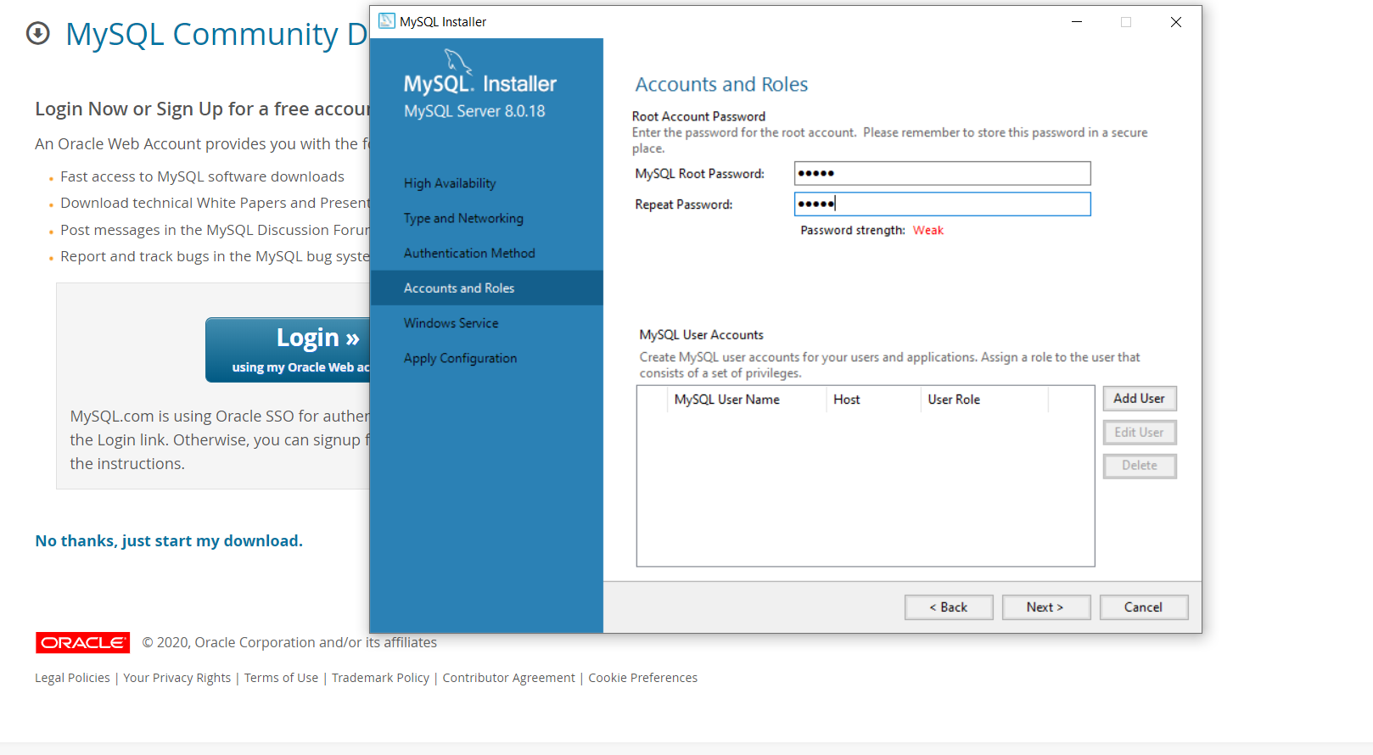
← Enter root password and make a note of it. WRITE IT SOMEWHERE SAFE.
YOU WILL NEED TO REMEMBER IT!!
Click on Add User button -->

Slide 26

← Enter username and password. WRITE IT DOWN.
YOU WILL NEED TO REMEMBER THIS FOR LOGIN!!

Slide 27

← Click on OK button

Slide 28

Click on Next button -->

Slide 29
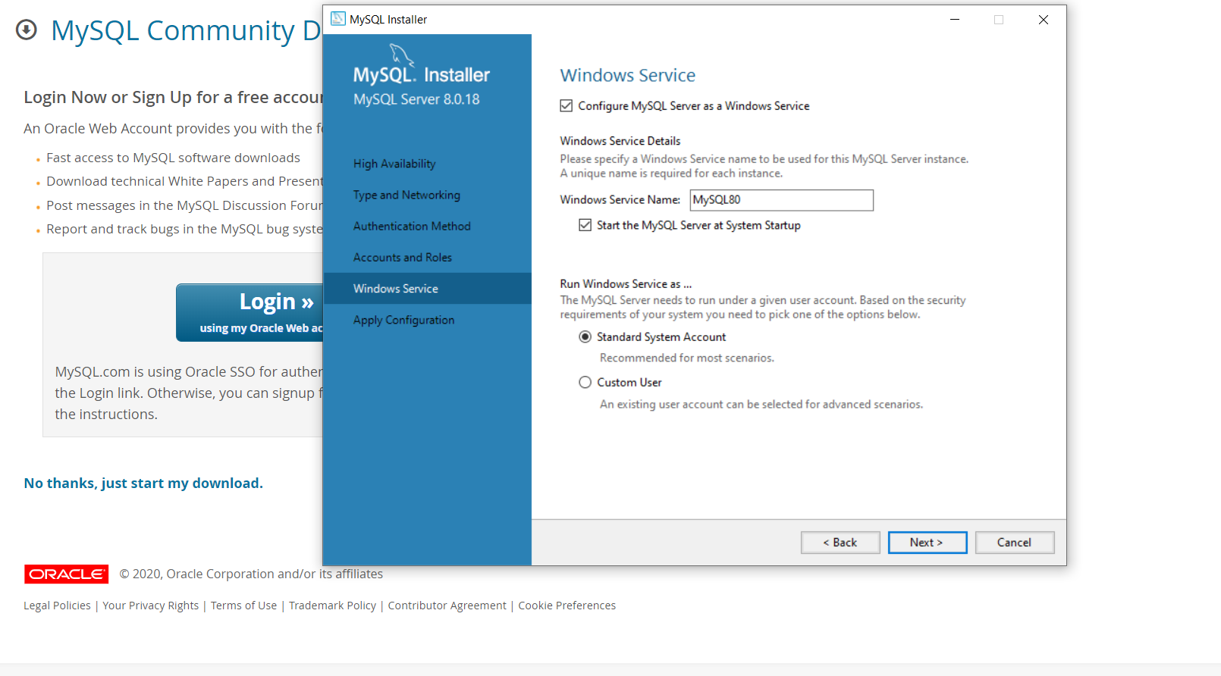
Click on Next button -->

Slide 30

Click on Execute button -->

Slide 31

Wait...

Slide 32

Click on Finish button -->

Slide 33

Click on Next button -->

Slide 34

Click on Finish button -->

Slide 35

Click on Next button -->

Slide 36

← Enter username and password that I asked you to remember for login. Click on Check button.

Slide 37
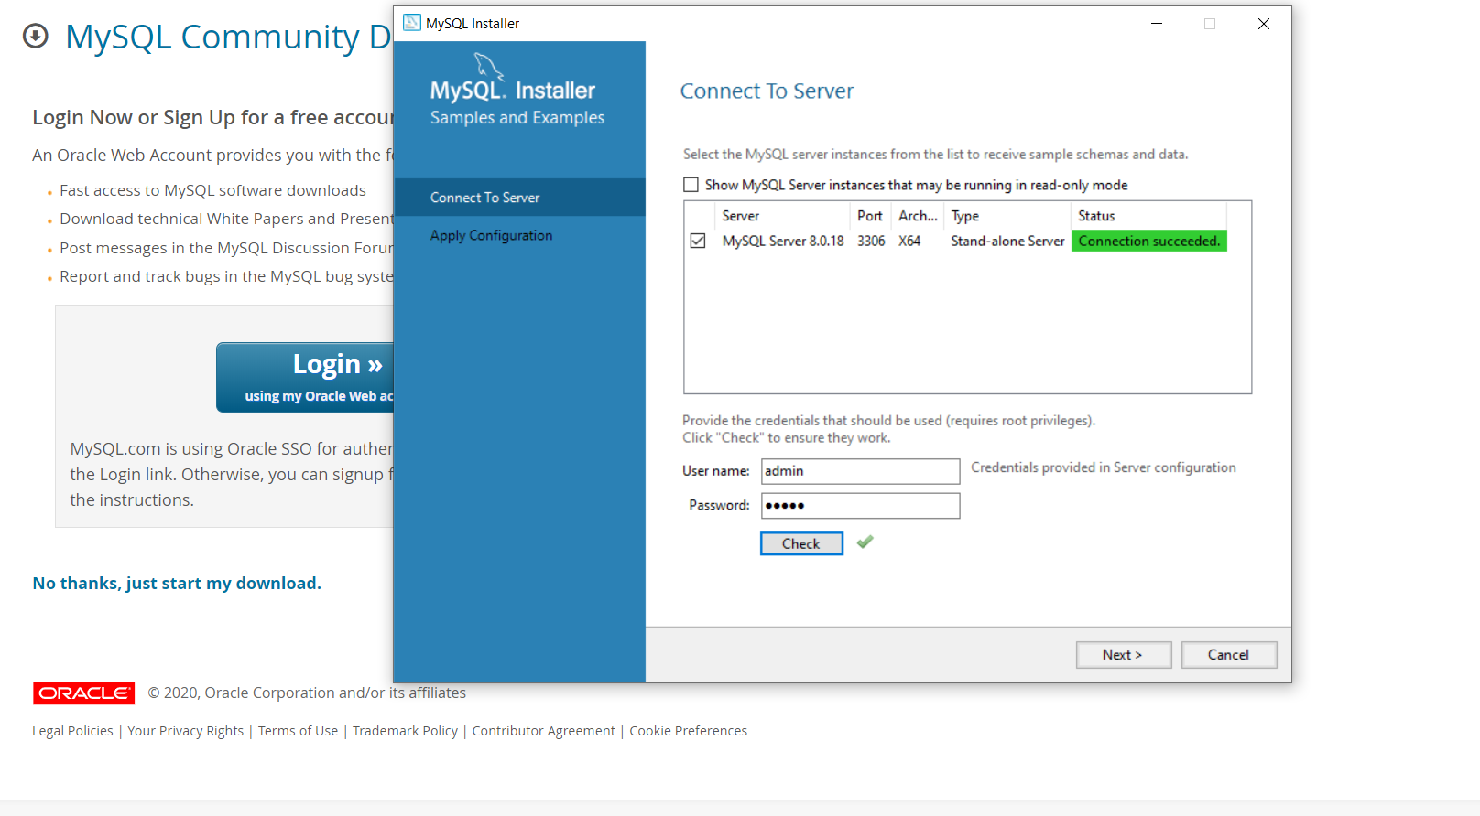
Click on Next button -->

Slide 38

Click on Execute button -->

Slide 39

Wait...

Slide 40
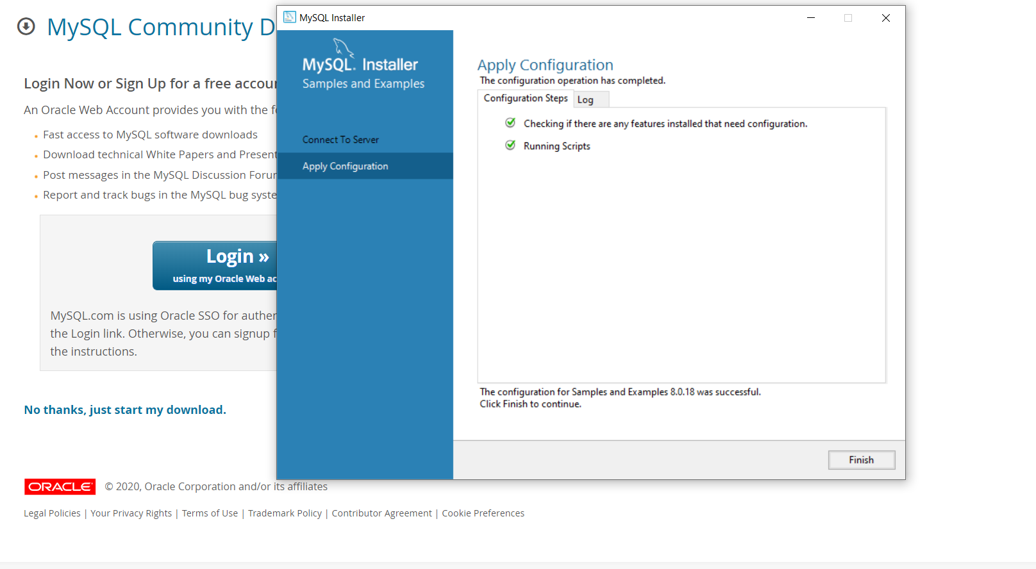
Click on Finish button -->

Slide 41

Click on Next button -->

Slide 42
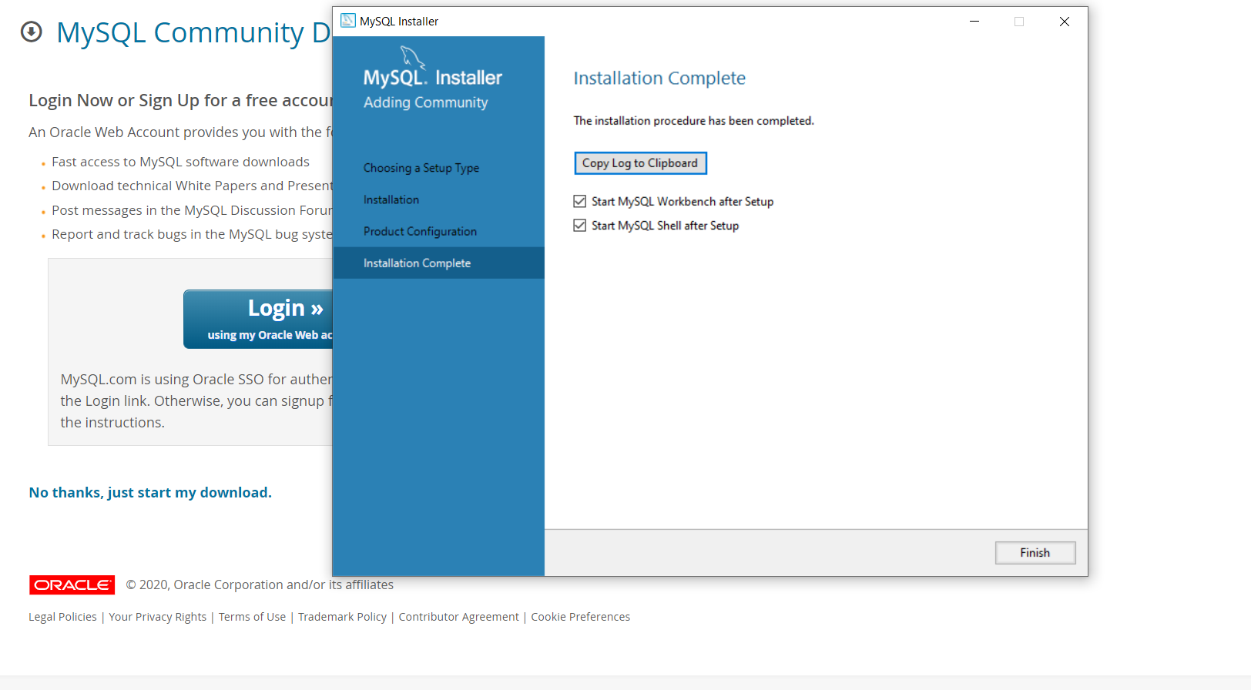
← Uncheck both of these checkboxes.
Click on Finish button -->

Slide 43
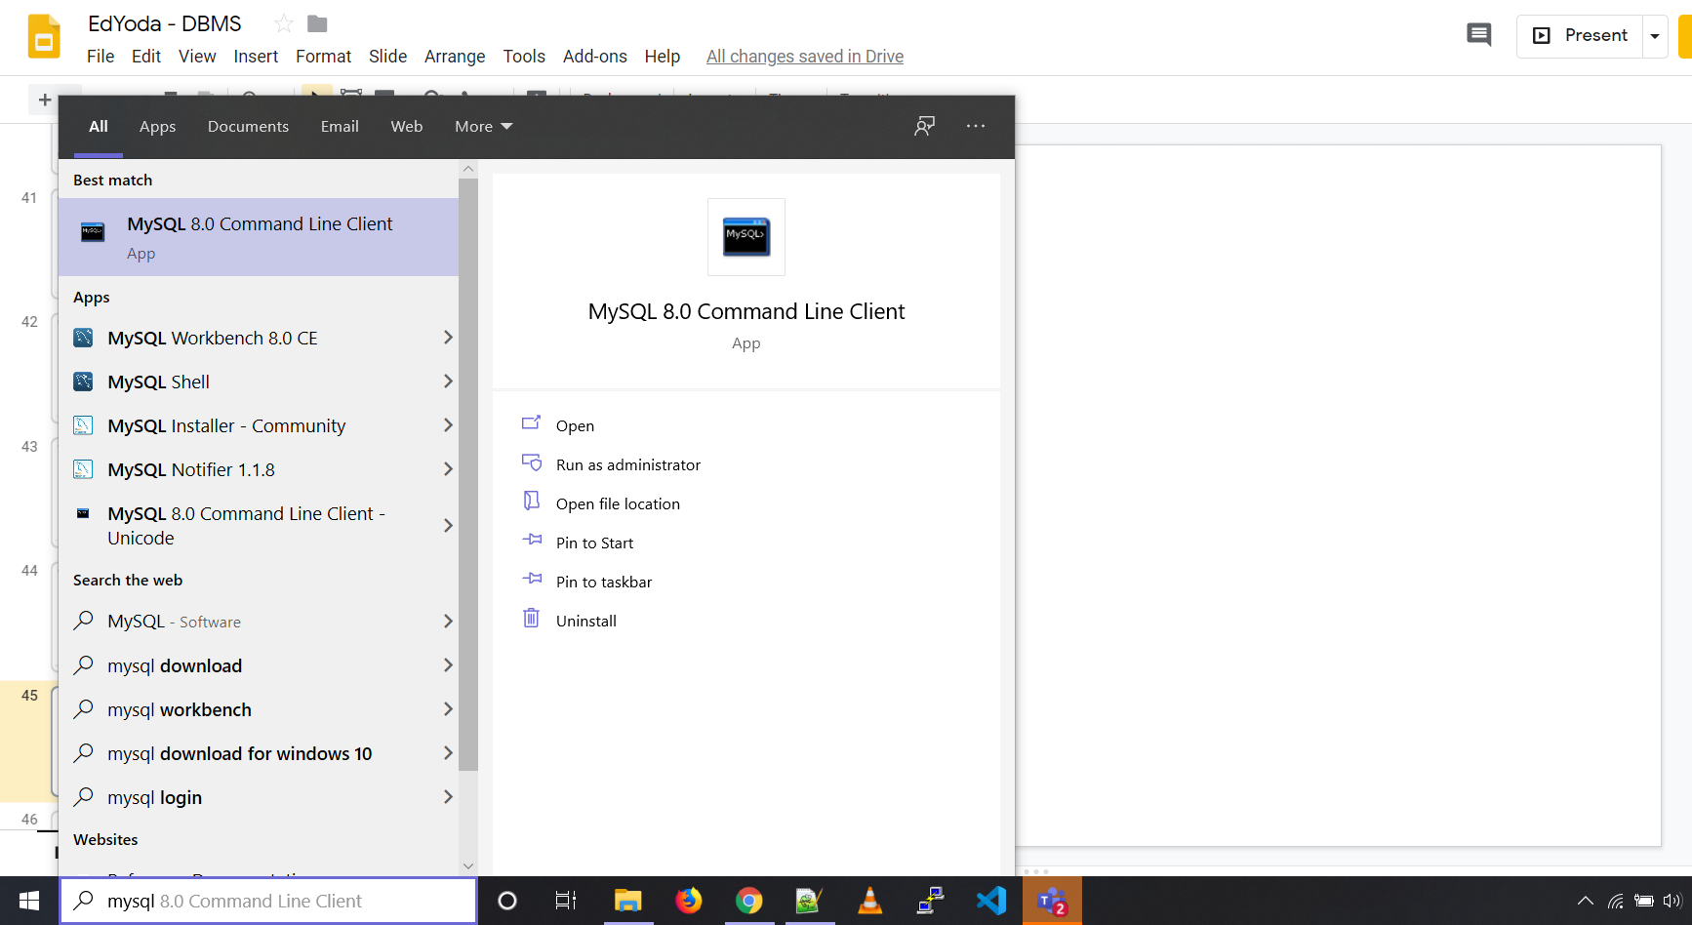
← Click on MySQL Command Line Client to Open it.
← Search for MySQL in your search box

Slide 44
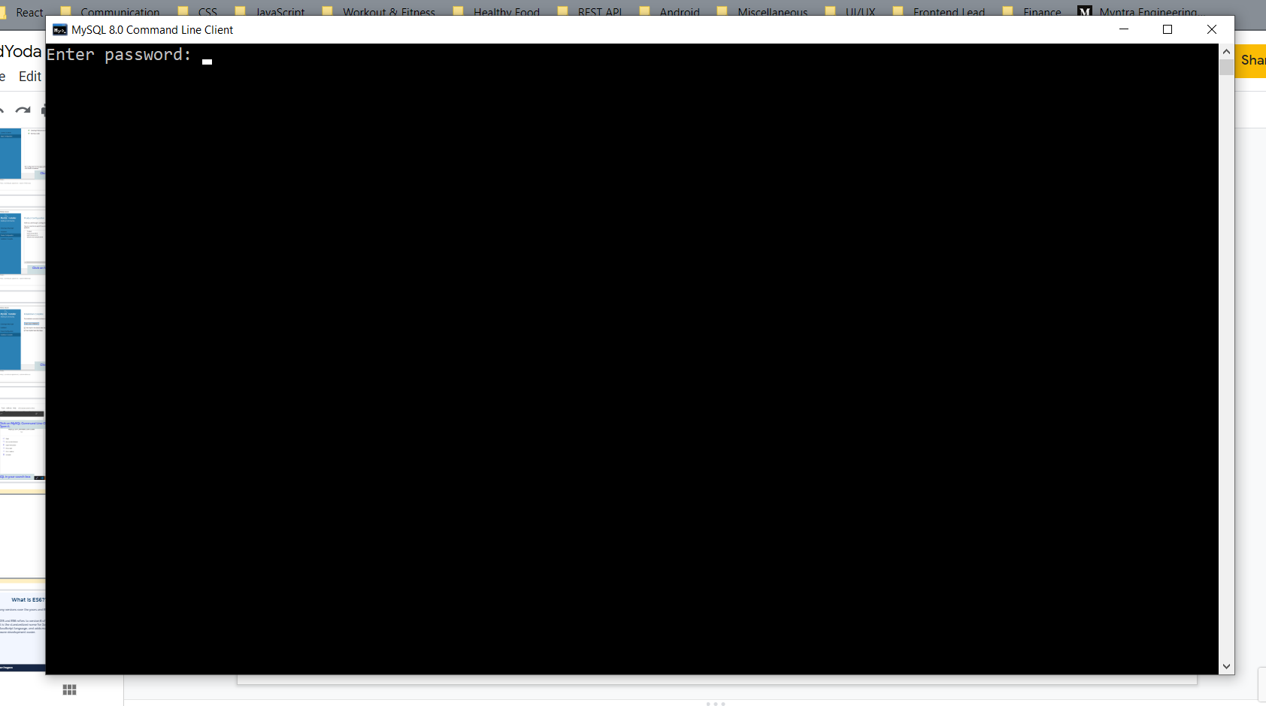
← Enter the root password.

Slide 45
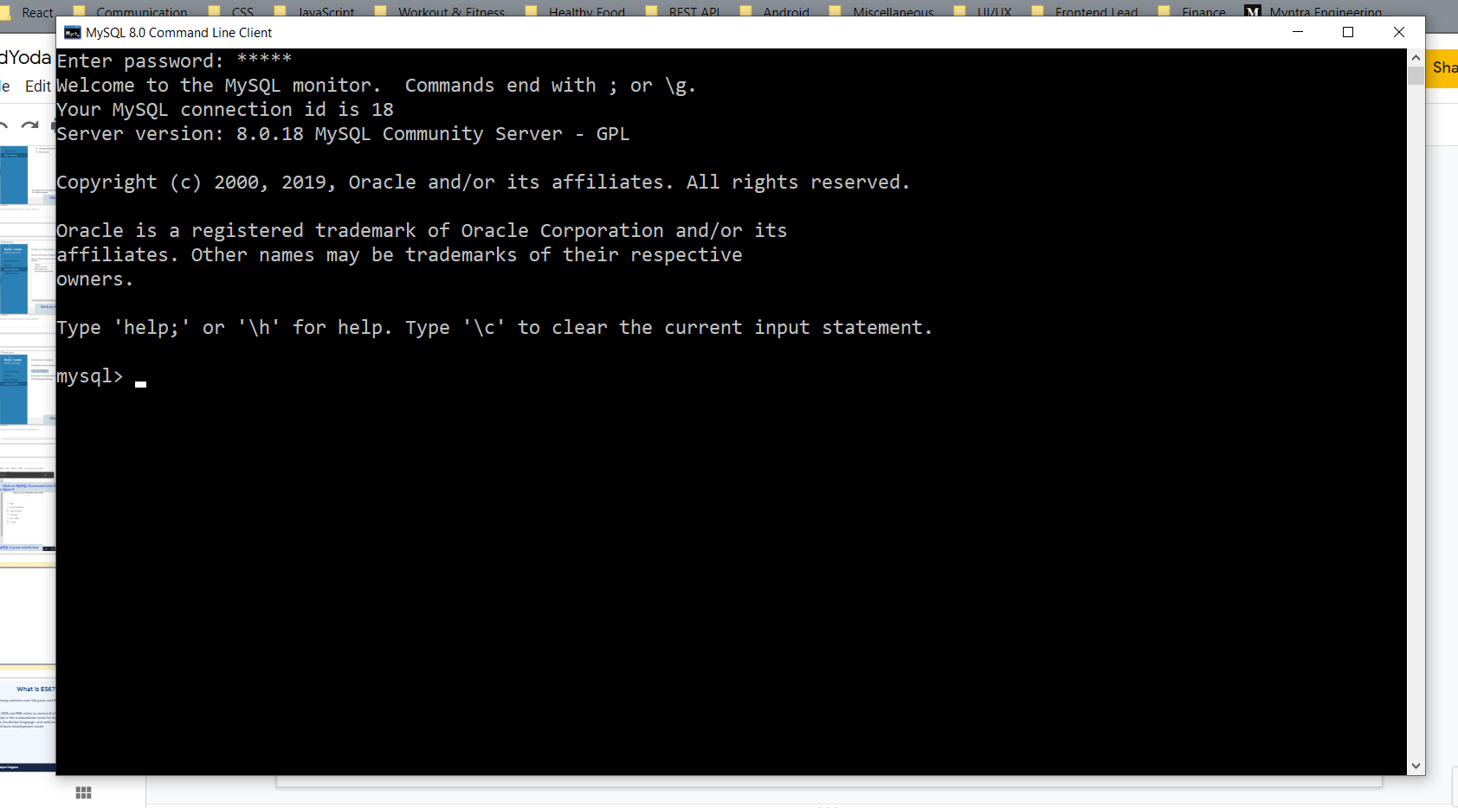
You are logged-in...

Slide 46

← Run this command

Slide 47

← If you got something like this then CONGRATS!!! You have configured MySQL Successfully!!

Slide 48
CRUD OPERATIONS

Slide 49
CRUD Operations
CRUD stands for:
CREATE
READ
UPDATE
DELETE
EdYoda - Developer Programs
https://www.edyoda.com

Slide 50
Create a Database
Syntax to create a Database:
create database {DatabaseName};
For example,
create database edyodamockdb;
Note:
To perform any table related task, first you have to select the DB.
For eg,
show tables; //This would give you an error.
use {DatabaseName};
EdYoda - Developer Programs
https://www.edyoda.com

Slide 51
Create Table
Syntax to Create a new table:
create table {TableName} (
ColumnOne datatype,
ColumnTwo datatype,
ColumnThree datatype,
....
);
EdYoda - Developer Programs
https://www.edyoda.com

Slide 52
Column Datatypes
Some data types supported by MySQL:
char(size): stores a fixed number of bytes no matter how many characters occupy a field of this type per row.
varchar(size): stores a variable number of bytes for only the space required by the content.
int: can be to store a number between -2147483648 to 2147483647.
bool: false is stored as 0, true is stored as 1.
datetime: Stores a date and time combination. Format: YYYY-MM-DD hh:mm:ss.
Datatypes References:
https://www.w3schools.com/sql/sql_datatypes.asp
https://dev.mysql.com/doc/refman/8.0/en/data-types.html
EdYoda - Developer Programs
https://www.edyoda.com

Slide 53
Create Table
For example,
create table User (
id int,
username varchar(24),
firstname varchar(255),
lastname varchar(255),
email varchar(255)
);
EdYoda - Developer Programs
https://www.edyoda.com

Slide 54
Adding Data in a Table
Syntax to add rows in a table:
Insert into {TableName}
values (value1, value2, value3, ...);
Note: The sequence of the values need to be same as that of columns.
For eg,
insert into user
values (1, ‘john1’, ‘John’, ‘Wick’, ‘john.wick@gmail.com’);
EdYoda - Developer Programs
https://www.edyoda.com

Slide 55
Fetch Data from a Table
Syntax to fetch data from all columns:
select * from {TableName};
For example,
select * from user
Syntax to fetch data for specific columns:
select ColumnOne, ColumnTwo, ...
from {TableName};
For example:
select username, email from user;
EdYoda - Developer Programs
https://www.edyoda.com

Slide 56
Fetch Data from a Table
Syntax to fetch unique data from specific column(s):
select distinct {ColumnName}, {ColumnName} from {TableName};
For example,
select distinct firstname from user;
Note:
When you use multiple columns with DISTINCT, it selects fields which are unique when combined together.
EdYoda - Developer Programs
https://www.edyoda.com

Slide 57
Fetch Filtered Data
Syntax to fetch filtered data:
select * from {TableName}
where {ColumnName}{Operator}{Value};
For example,
select * from users
where country=’IN’;
EdYoda - Developer Programs
https://www.edyoda.com

Slide 58
Fetch Filtered Data: Operators
= : Equal
> : Greater than
< : Less than
>= : Greater than or equal
<= : Less than or equal
!= : Not equal.
AND : It displays a record if all the conditions separated by AND are TRUE.
OR : It displays a record if any of the conditions separated by OR is TRUE.
NOT : It displays a record if the condition(s) is NOT TRUE.
BETWEEN: Between a certain range
LIKE : Search for a pattern
IN : To specify multiple possible values for a column
EdYoda - Developer Programs
https://www.edyoda.com

Slide 59
AND Operator
Syntax:
SELECT {ColumnOne}, {ColumnTwo}, ...
FROM {TableName}
WHERE condition1 AND condition2 AND condition3 ...;
For example,
Find all the female french students.
SELECT *
FROM user
WHERE country=”FR” AND gender=”Female”;
EdYoda - Developer Programs
https://www.edyoda.com

Slide 60
OR Operator
Syntax:
SELECT {ColumnOne}, {ColumnTwo}, ...
FROM {TableName}
WHERE condition1 OR condition2 OR condition3 ...;
For example,
Find all students who are either French or Australian
SELECT *
FROM user
WHERE country=”FR” OR country=”AU”;
Note: You can also use IN operator for the same
SELECT * FROM user WHERE country IN (”FR”, ”AU”);
EdYoda - Developer Programs
https://www.edyoda.com

Slide 61
NOT Operator
Syntax:
SELECT {ColumnOne}, {ColumnTwo}, ...
FROM {TableName}
WHERE NOT condition;
For example,
Find all students who are not Danish.
SELECT *
FROM user
WHERE NOT country=”DE”;
EdYoda - Developer Programs
https://www.edyoda.com

Slide 62
BETWEEN Operator
Syntax:
SELECT * FROM {TableName}
WHERE {ColumnName} BETWEEN {VALUE1} AND {VALUE2};
For example,
Find all the students who are between 20 and 30 years old.
SELECT * FROM user
WHERE age BETWEEN 20 AND 30;
NOTE: value1 and value2 are inclusive.
EdYoda - Developer Programs
https://www.edyoda.com

Slide 63
Sorting Results
Syntax:
SELECT {ColumnOne}, {ColumnTwo}, ...
FROM {TableName}
ORDER BY {ColumnOne}, {ColumnTwo},... ASC|DESC;
For example,
Find all the students older than 45 and sort them by age in ascending order.
SELECT * FROM user where age > 45
ORDER BY AGE ASC
Note:
When you give more columns in Order By, if two rows have same FirstColumn then it considers the ColumnTwo to decide the sequence.
EdYoda - Developer Programs
https://www.edyoda.com

Slide 64
LIKE Operator
Like operator can be used to search for patterns. It supports two wildcards -
% - It represents zero, one or more characters.
_ - It represents a single character.
Syntax: SELECT {ColumnOne}, {ColumnTwo}, … FROM {TableName}
Where {Column} LIKE ‘combination of wildcards and char’
For example,
first_name LIKE 'To%'; //Selects all the first_name starting with ‘To’.
first_name LIKE ‘%an’; //Selects all the first_name ending with ‘an’.
first_name LIKE ‘%ick%’ //Selects all the first_name containing ‘ick’;
first_name LIKE ‘_a%’ //Selects all the first_name with second char as ‘a’.
EdYoda - Developer Programs
https://www.edyoda.com

Slide 65
Finding Max and Min in a column
Syntax:
SELECT Max({ColumnOne})
FROM {TableName}
WHERE condition1 AND condition2 AND condition3 ...;
SELECT Min({ColumnOne})
FROM {TableName}
WHERE condition1 AND condition2 AND condition3 ...;
EdYoda - Developer Programs
https://www.edyoda.com

Slide 66
Finding Count, Average and Sum of a column
Syntax:
SELECT Count({ColumnOne})
FROM {TableName}
WHERE condition1 AND condition2 AND condition3 ...;
SELECT Avg({ColumnOne})
FROM {TableName}
WHERE condition1 AND condition2 AND condition3 ...;
SELECT Sum({ColumnOne})
FROM {TableName}
WHERE condition1 AND condition2 AND condition3 ...;
EdYoda - Developer Programs
https://www.edyoda.com

Slide 67
Constraints
Commonly used constraints:
NOT NULL - It defines that the column cannot have a null value.
UNIQUE - It defines that all the values in a column should be unique.
PRIMARY KEY - A combination of a NOT NULL and UNIQUE. Uniquely identifies each row in a table.
FOREIGN KEY - Uniquely identifies a row/record in another table.
EdYoda - Developer Programs
https://www.edyoda.com

Slide 68
Primary Key Constraint
Syntax:
CREATE TABLE {TableName}(
ID int AUTO_INCREMENT,
PRIMARY KEY (ID)
);
Note: You can use AUTO_INCREMENT to automatically increment the Primary Key.
EdYoda - Developer Programs
https://www.edyoda.com

Slide 69
Foreign Key Constraint
Syntax:
CREATE TABLE {TableName}(
tableID int,
otherTableID int,
PRIMARY KEY (tableID),
FOREIGN KEY (otherTableID) REFERENCES {OtherTableName}(otherTableID)
);
EdYoda - Developer Programs
https://www.edyoda.com

Slide 70
ER DIAGRAMS

Slide 71
ER Diagram
It is a high level conceptual data modeling.
It helps to analyze the data requirements to create well-designed databases.
It represent real-world entities and the relations between them.
Components of ER Diagrams
Entities - It could be anything in the world - living or non-living for which we need to store data.
Attributes - The properties to represent the entities.
Relationships - The relationships between different entities.
EdYoda - Developer Programs
https://www.edyoda.com

Slide 72
Why ER Diagram?
Say you have to build e-commerce, or school website etc.
The problem statement is very abstract. We need to translate the problem statement to tables & relationships.
It helps to understand the logical structure of a database by presenting it visually.
EdYoda - Developer Programs
https://www.edyoda.com

Slide 73
Entity
Person - Teacher, Student
Place - Building, House
Object - Car
Concept - Account
EdYoda - Developer Programs
https://www.edyoda.com

Slide 74
Attributes
It is a single-valued property of either an entity-type or a relationship-type.
Types of attribute
Simple Attribute
Composite Attribute
Derived Attribute
Multi-valued attribute
EdYoda - Developer Programs
https://www.edyoda.com

Slide 75

Relationships (Cardinality)
EdYoda - Developer Programs
https://www.edyoda.com

Slide 76
Steps for creating ERD
Entity Identification
Identify Attributes
Cardinality Identification
EdYoda - Developer Programs
https://www.edyoda.com

Slide 77
Entities in E-Learning Platform
User
Course
Video
Assignment
Rating
Payment
Review
Categories
Likes
EdYoda - Developer Programs
https://www.edyoda.com

Slide 78
JOIN

Slide 79
JOIN
A JOIN clause is used to combine rows from two or more tables, based on a related column between them.
(INNER) JOIN: Returns records that have matching values in both tables
LEFT (OUTER) JOIN: Returns all records from the left table, and the matched records from the right table
RIGHT (OUTER) JOIN: Returns all records from the right table, and the matched records from the left table
FULL (OUTER) JOIN: Returns all records when there is a match in either left or right table
EdYoda - Developer Programs
https://www.edyoda.com

Slide 80
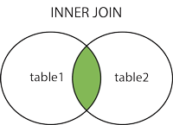
INNER JOIN
(INNER) JOIN: Returns records that have matching values in both tables
The INNER JOIN keyword selects all rows from both the tables as long as the condition satisfies i.e value of the common field will be same.
EdYoda - Developer Programs
https://www.edyoda.com

Slide 81
INNER JOIN
Syntax:
SELECT table1.column1,table1.column2,table2.column1,....
FROM table1
INNER JOIN table2
ON table1.matching_column = table2.matching_column
WHERE table1.column=val….;
EdYoda - Developer Programs
https://www.edyoda.com

Slide 82
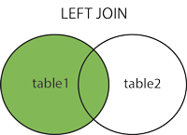
LEFT OUTER JOIN
LEFT (OUTER) JOIN: Returns all records from the left table, and the matched records from the right table.
The rows for which there is no matching row on right side, the result-set will contain null.
EdYoda - Developer Programs
https://www.edyoda.com

Slide 83
LEFT JOIN
Syntax:
SELECT table1.column1,table1.column2,table2.column1,....
FROM table1
LEFT JOIN table2
ON table1.matching_column = table2.matching_column
WHERE table1.column=val….;
EdYoda - Developer Programs
https://www.edyoda.com

Slide 84
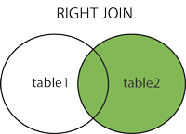
RIGHT OUTER JOIN
RIGHT (OUTER) JOIN: Returns all records from the right table, and the matched records from the left table.
The rows for which there is no matching row on right side, the result-set will contain null.
EdYoda - Developer Programs
https://www.edyoda.com

Slide 85
RIGHT JOIN
Syntax:
SELECT table1.column1,table1.column2,table2.column1,....
FROM table1
RIGHT JOIN table2
ON table1.matching_column = table2.matching_column
WHERE table1.column=val….;
EdYoda - Developer Programs
https://www.edyoda.com

Slide 86
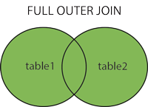
FULL OUTER JOIN
FULL (OUTER) JOIN: Returns all records when there is a match in either left or right table.
The result is a combination of result of both LEFT JOIN and RIGHT JOIN. The result will contain all the rows from both the tables.
The rows for which there is no matching, the result-set will contain NULL values.
EdYoda - Developer Programs
https://www.edyoda.com

Slide 87
FULL JOIN
Syntax:
SELECT table1.column1,table1.column2,table2.column1,....
FROM table1
FULL JOIN table2
ON table1.matching_column = table2.matching_column
WHERE table1.column=val….;
EdYoda - Developer Programs
https://www.edyoda.com

Slide 88
Adding new user to MySQL
Add new user to mysql database
mysql> CREATE USER 'edyoda'@'localhost' IDENTIFIED BY 'Abcd@1234';
mysql> GRANT ALL PRIVILEGES ON * . * TO 'edyoda'@'localhost';
mysql> FLUSH PRIVILEGES;
Installing python connector # pip install mysql-connector-python
EdYoda - Developer Programs
https://www.edyoda.com

Slide 89
Connecting Python to MySQL
import mysql.connector
mydb = mysql.connector.connect(
host="localhost",
user="edyoda",
passwd="Abcd@1234"
)
print(mydb)
MySQL
EdYoda - Developer Programs
https://www.edyoda.com

Slide 90
Create database using Python on MySQL
mycursor = mydb.cursor()
mycursor.execute("CREATE DATABASE mydb")
mydb
EdYoda - Developer Programs
https://www.edyoda.com

Slide 91
Creating table in MySQL using Python
mycursor.execute("CREATE TABLE Product (name VARCHAR(255), address VARCHAR(255))")
mycursor = mydb.cursor()
mycursor.execute("SHOW TABLES")
for x in mycursor:
print(x)
EdYoda - Developer Programs
https://www.edyoda.com

Slide 92
Creating table in MySQL using Python
mycursor.execute("CREATE TABLE Product (type VARCHAR(255), name VARCHAR(255))")
mycursor = mydb.cursor()
mycursor.execute("SHOW TABLES")
for x in mycursor:
print(x)
EdYoda - Developer Programs
https://www.edyoda.com

Slide 93
Insert into table in MySQL using Python
mycursor = mydb.cursor()
sql = "INSERT INTO Product (type, name) VALUES (%s, %s)"
val = ("Book", "Shoe Dog")
mycursor.execute(sql, val)
mydb.commit()
print(mycursor.rowcount, "record inserted.")
EdYoda - Developer Programs
https://www.edyoda.com

Slide 94
Insert many into table in MySQL using Python
sql = "INSERT INTO Product (type, name) VALUES (%s, %s)"
val = [
('Book', 'Shoe Dog'),
('Shoe', ‘Nike’)
]
mycursor.executemany(sql, val)
mydb.commit()
print(mycursor.rowcount, "was inserted.")
EdYoda - Developer Programs
https://www.edyoda.com

Slide 95
Select from table in MySQL using Python
mycursor = mydb.cursor()
mycursor.execute("SELECT * FROM Product")
myresult = mycursor.fetchall()
for x in myresult:
print(x)
EdYoda - Developer Programs
https://www.edyoda.com

Slide 96
Delete from table in MySQL using Python
mycursor = mydb.cursor()
sql = "DELETE FROM Product WHERE type = ''"
mycursor.execute(sql)
mydb.commit()
print(mycursor.rowcount, "record(s) deleted")
EdYoda - Developer Programs
https://www.edyoda.com

Slide 97
Project : CareAll
Use case Diagram
Things Done by CareSeeker
Create Care Seeker Account
Select Care taker
Give review or rating to people you have interacted with
Things to be
EdYoda - Developer Programs
https://www.edyoda.com

Slide 98
Project : CareAll
Class Diagram
Classes
Create Care Seeker Account
Select Care taker
Give review or rating to people you have interacted with
Things to be
EdYoda - Developer Programs
https://www.edyoda.com

